Slide 1









UPRM Makers Space Challenge
An opportunity presented by the partners in the UPRM E-Ship Network
Para Inscripciones presione aquí

Slide 2
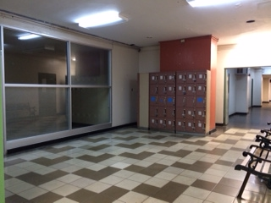
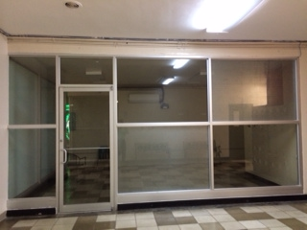
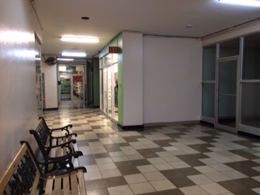
The opportunity…to start and get things done is now….
Prime space available
at the Centro de
Estudiantes

Slide 3
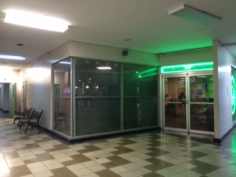
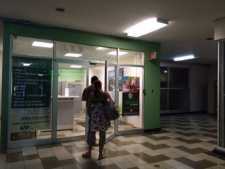
A few steps from La Cueva de
Tarzan
Next to Cooperativa La Primera

Slide 4
The Vision
Create an INTERdisciplinary free and mind stimulating space where Hyspters, Hackers and Hustlers meet and work in teams to develop, validate and grow IDEAS for new products and services to reach the Marketplace.

Slide 5
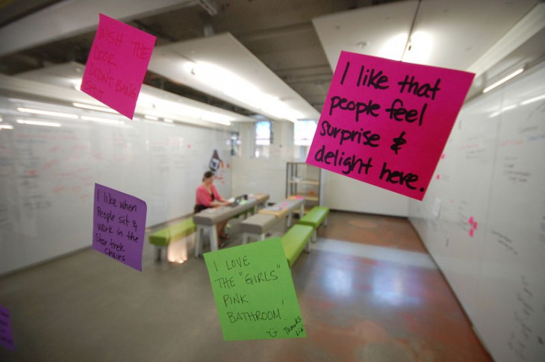
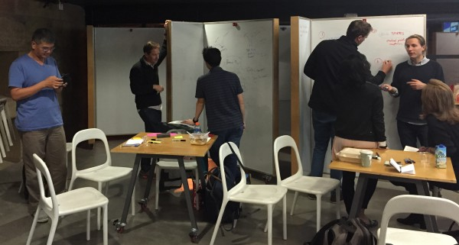
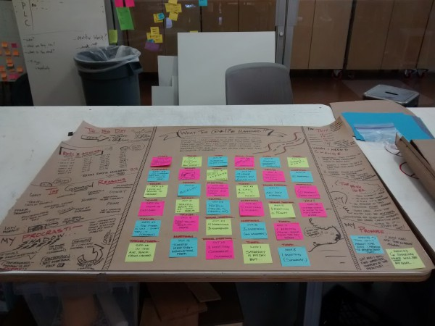
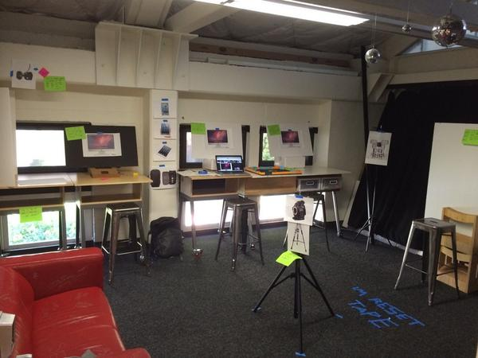
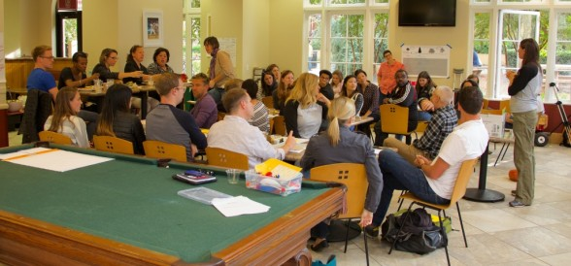
What it could be…..

Slide 6
Facts & guiding principles
An entrepreneur is a person that takes advantage of opportunities regardless of resources under his/her control.
A business venture is an interdisicplinary team effort.
You can create wealth while simultaneously advancing the common good.
Innovation is driven by universities as intelectual catalysts.
UPRM students represent a proven talent pool for start ups ventures in Puerto Rico.

Slide 7
The challenge
A proposal of your team vision to develop the makers space.
  Interdisciplinary teams of minimum 4 students (grads and undergrads) must submit a 2-3 minute video for evaluation by a panel of judges in a semifinal round.
  Finalists will make a pitch of up to 5 minutes to experts and submit a proposal brief in a final round. Judges decision will be final.
Teams must include students from at least 2 deanships (decanatos) and 3 disciplines.

Slide 8
Judging Criteria
Team capabilities
Makers space design vision
Makers space program management description
Strategies for campus wide student engagement
Sustainable business model: in philosophy and financially
Resources contributed by the team to the efforts
Time table for implementation beginning on the summer 2015

Slide 9
What’s in it for the winners?
An investment of $5,000 for starting right away the implementation of their vision.
Access to assistance and collaboration of members of the UPRM E-ship Network for implementation.

Slide 10
Important dates
Public announcement in the H3 meet up at Teatro Carmen Mayagüez: March 26
Pre register for teams: Abril 11 (http://uprm.edu/cnde)
Semi finals: April 17 (submissions of videos)
Pitch coaching session: April 24
Finals: May 1
Ribbon cutting during the Small Business Week –
May 11-15

Slide 11
Inquiries:
Moraima De Hoyos- Ruperto moraima.dehoyos1@upr.edu
Jose Vega jose.vega18@upr.edu
Facebook: UPRMeship Network
Centro de Negocios y Desarrollo Económico del RUM
http://uprm.edu/cnde

Slide 12
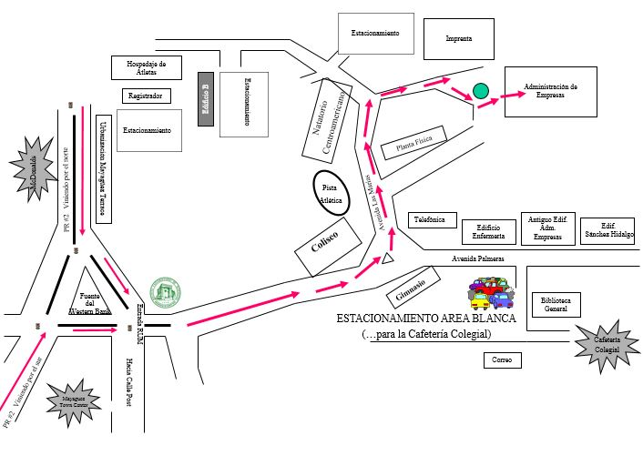
Mapa

